Slide 1
The 1-Page Performance Framework
Simple, scalable performance for fast-growing teams

Slide 2
Why Performance Needs Structure
Startups and scale-ups often skip structured performance management. But top talent needs clarity. This framework keeps it simple, with a single page approach that scales.

Slide 3
What’s Inside
Quarterly OKRs or KPIs
Regular check-ins (bi-weekly or monthly)
Feedback loops (360° or manager-led)
Simple career paths or development plans

Slide 4
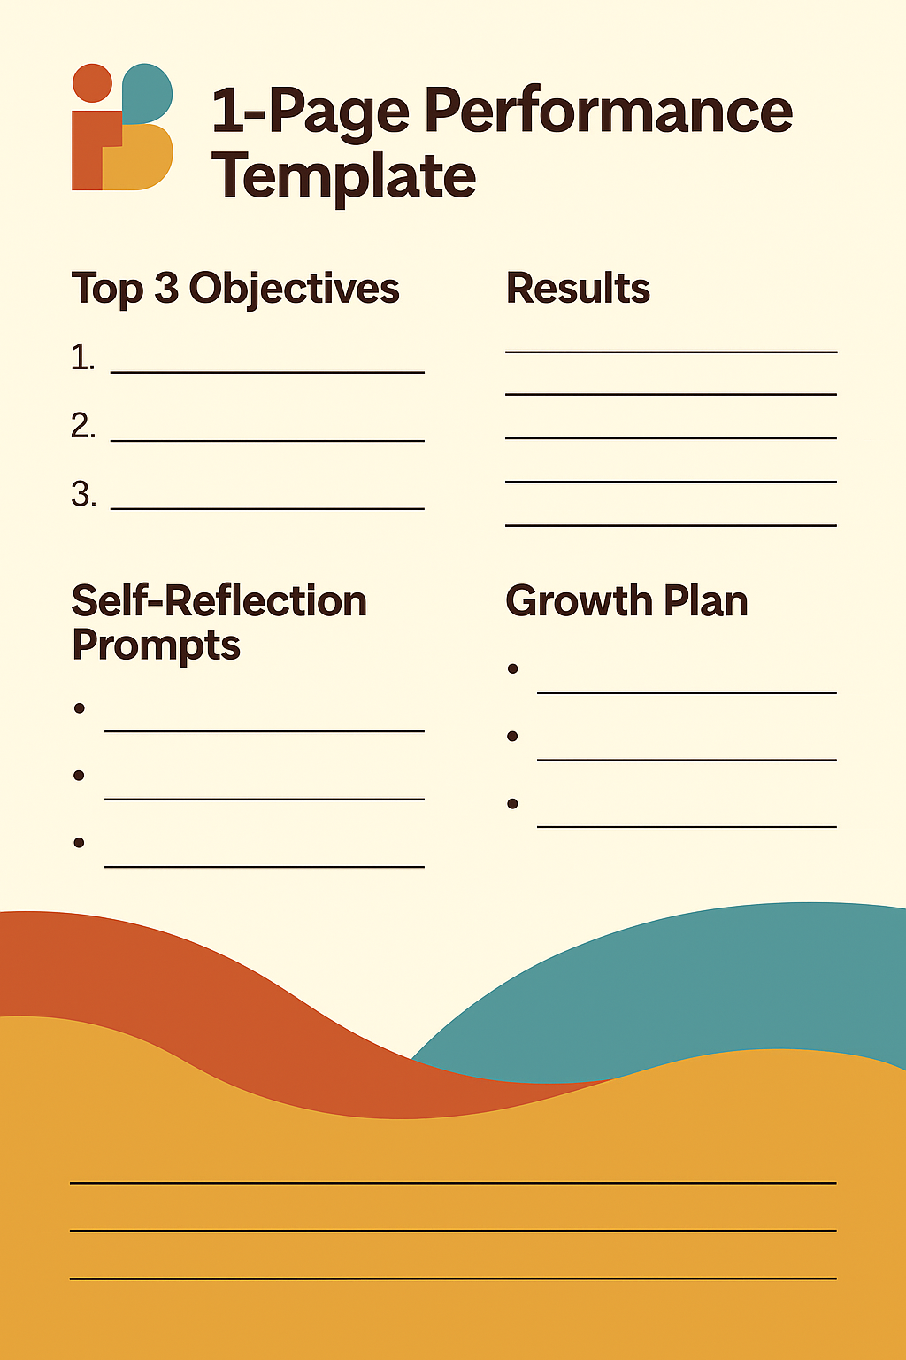
Top 3 Objectives and Key Results
Manager feedback area
Self-reflection prompts
Development actions and goals

Slide 5
Best Practices
Keep language action-oriented
Tie goals to business impact
Schedule performance conversations quarterly
Make development part of your EVP

Slide 6
Need a Simple Performance System?
We help growth-stage companies roll out performance tools that work for busy teams.
📩 hello@peoplebuiltmt.com
🌐 www.peoplebuiltmt.com
📞 +356 99805821

